Slide 1
Lectuer-14 Database Design and Applications
Ashish Narang

Slide 2
First Semester
2020-21

Slide 3
Contents
Implementation of various operations
Steps in query processing
SQL to relational expressions
Query Optimization

Slide 4
External Sorting
External sorting refers to sorting algorithms that are suitable for large files of records stored on disk that do not fit entirely in main memory, such as most database files.
The typical external sorting algorithm uses a sort-merge strategy, which starts by sorting small sub files—called runs—of the main file and then merges the sorted runs, creating larger sorted sub files that are merged in turn.

Slide 5
Sort Merge Strategy
In the sorting phase, runs (portions or pieces) of the file that can fit in the available buffer space are read into main memory, sorted using an internal sorting algorithm, and written back to disk as temporary sorted sub files (or runs).
In the merging phase, the sorted runs are merged during one or more merge passes. Each merge pass can have one or more merge steps. The degree of merging (d_{M}) is the number of sorted sub files that can be merged in each merge step.

Slide 6
Implementing Select
Search methods for simple Selection:
The searching algorithms for selecting records from a file are known as file scans.
If the searching algorithm involves the use of indexes it is called as index scan.
The following methods are used to implement a select operation.
Linear search (brute force)
Binary search
Using a primary index/hash key (if the key attribute is involved)
Using a primary index to retrieve multiple records
Using a clustering index to retrieve multiple records
Using a secondary index (B+ tree) on equality condition

Slide 7
Implementing Project Operation
If the PROJECT operation includes the key of the relation then the number of tuples in the result are same as that of the relation, but with values for the other attributes of the tuple.
If it does not include the key, then the duplicates must be eliminated. This is done by sorting the result tuples and eliminating duplicates.
This duplicate elimination can also be done by hashing. Each record is hashed and is inserted into a bucket of the hash file in memory, it is checked against those already in he bucket; if it a duplicate, it is not inserted.

Slide 8
Implementing Join
If relation R is joined with S on R.A=S.B
Nested-loop join (brute forcing)
For every record t in R (outer loop), retrieve every record from S (inner loop) and test if they satisfy the join condition.
Single-loop join (using an access structure to retrieve matching records)
If there exists an indexing for one of the attributes used in joining, say B in S, then for each record in R, retrieve all records in S using the access path.

Slide 9
Contd..
3. Sort-merge join
If records in R and S are physically sorted by value of join attribute A and B, both files are scanned concurrently in order of join attributes, matching the records that have the same values for A and B.
Hash join
The records of R and S are hashed to the same hash file using the same hash function on the join attributes A of R and B of S as hash keys.
Partitioning- First , the file with fewer records (say R)is hashed to buckets.
Probing- a single phase through the other file S hashes records to probe the appropriate bucket, and combine matching records of R in the bucket.

Slide 10
Implementing Set Operations
The other Set operations- UNION, INTERSECTION, SET DIFFERENCE apply to only union compatible relations, which have the same number of attributes and same attribute domains in the same order.
A variation of sort-merge technique is used. Two relations are sorted on the same attribute and after sorting a single scan through each relation is sufficient to produce the result.
Hashing can be used for these operations.
First partition one of the relations say R, and hash the records of S (probe).

Slide 11
Implementing Aggregate operations and GROUP BY
For MAX operator, indexes can be used if available.
If index is available, the rightmost pointer in each index node can be followed.
For MIN operator, indexes can be used if available.
If index is available, the leftmost pointer in each index node can be followed.
For COUNT, SUM and AVERAGE operators, indexes can be used if they are dense.
If it is non-dense, then actual number of records for each index entry must be used.
For GROUP BY clause- first sorting or hashing is to be done on the grouping attributes to partition the file to appropriate groups. Later the other aggregate operations can be performed on the individual groups.

Slide 12
Steps in Query Processing
Query in high-level Language (SQL)
Scanning/parsing/validation
Internal representation of the query
Query Optimizer
Execution Plan
Query Code generator
Code to execute the query
Runtime Database processor
Result of Query

Slide 13
Query Optimization
Query optimization is the process of choosing a suitable strategy from the available set of strategies for the query.
In this process- first an SQL query is translated into an equivalent relational algebra expression, then represented as a query tree data structure. This intermediate form or representation which is then optimized.

Slide 14
Translating SQL Queries into Relational
Algebra
Typically, SQL queries are decomposed into query blocks, which form the basic units that can be translated into the algebraic operators and optimized.
A query block contains a single SELECT-FROM-WHERE expression, as well as GROUP BY and HAVING clauses if these are part of the block. Hence, nested queries within a query are identified as separate query blocks.

Slide 15
Example
Consider the following SQL query.
SELECT Lname, Fname
FROM EMPLOYEE
WHERE Salary > ( SELECT MAX (Salary)
FROM EMPLOYEE
WHERE Dno=5 );
This query retrieves the names of employees (from any department in the company) who earn a salary that is greater than the highest salary in department 5.

Slide 16
Contd..
The query includes a nested subquery and hence would be decomposed into two blocks.
The inner block is:
( SELECT MAX (Salary)
FROM EMPLOYEE
WHERE Dno=5 )
This retrieves the highest salary in department 5.
The outer query block is:
SELECT Lname, Fname
FROM EMPLOYEE
WHERE Salary > c
where c represents the result returned from the inner block.

Slide 17

Contd..
The inner block could be translated into the following extended relational algebra expression:
The outer block can be translated into the expression:

Slide 18
Query Tree
A Query Tree is a tree data structure that corresponds to a relational algebra expression.
It represents the input relations of the query as leaf nodes of the tree, and internal nodes represents the relational algebra operations as internal nodes.
The execution of the query tree consists of executing an internal node operation whenever its operands are available and then replacing the internal node by the relation that results from executing the operation.
The execution terminates when the root node is executed and produces the result relation for the query.

Slide 19
Contd..
SELECT Fname , salary
FROM EMPLOYEE, DEPARTMENT
WHERE Dname=‘Accounts’ and Dno=Dnumber;
π_{Fname, salary} (EMPLOYEE _{Dno=Dnumber} (σ _{Dname=‘Accounts’} (Department)))
π_{Fname, salary}
σ Dname=‘Accounts’ AND Dno=Dnumber
X
D
E
Initial query tree

Slide 20
Query Graph
Another representation of a query is query graph.
Relations in the query are represented by relation nodes, which are displayed as single circles.
Constant values, typically from the query selection conditions, are represented by constant nodes, which are displayed as double circles or ovals.
Selection and join conditions are represented by the graph edges.
The attributes to be retrieved from each relation are displayed in square brackets above each relation.
Query graphs will not indicate the order of operations.
As an optimizer needs to show the order of operations for the query, query trees are preferred.

Slide 21
Contd..
SELECT Fname , salary
FROM EMPLOYEE, DEPARTMENT
WHERE Dname=‘Accounts’ and Dno=Dnumber;
π_{Fname, salary} (EMPLOYEE _{Dno=Dnumber} (σ _{Dname=‘Accounts’} (Department)))
[Fname, salary]
Dno=Dnumber
D
E
_{Dname=‘Accounts’}
‘Account’s
Query Graph corresponding to the RA query

Slide 22
Heuristic Optimization of Query Trees
A query parser will generate a standard initial query tree that corresponds to the SQL query, without doing any optimization.
These initial trees are inefficient if executed directly.
Now it is the job of the heuristic query optimizer to transform this initial query tree into a final query tree that is reasonably efficient.
The optimizer must include rules for equivalence among relational algebra expressions that can be applied to initial tree.
Heuristic query optimization rules then utilize these equivalence expressions to transform the initial tree into the final, reasonably optimized query tree.

Slide 23
Example
π_{Fname, salary,ssn}
π_{Fname, salary, ssn}
σ Dname=‘Accounts’ AND Dno=Dnumber
σ_{Dno=Dnumber}
X
X
D
E
σ _{Dname=‘Accounts’}
E
D

Slide 24
Contd..
π_{Fname, salary, ssn}
π_{Fname, salary, ssn}
σ_{Dno=Dnumber}
σ_{Dnumber=Dno}
X
X
π_{Dnumber}
E
π_{Dnumber}
π_{ssn,Dno,Fname,salary}
σ _{Dname=‘Accounts’}
σ _{Dname=‘Accounts’}
E
D
D

Slide 25
Contd..
π_{Fname, salary, ssn}
Dno=Dnumber’
π_{Dnumber}
π_{ssn,Dno,Fname,salary}
σ _{Dname=‘Accounts’}
E
D

Slide 26
Example 2
SELECT Lname
FROM EMPLOYEE, WORKS_ON, PROJECT
WHERE Pname=‘Aquarius’ AND Pnumber=Pno AND Essn=Ssn AND Bdate > ‘1957-12-31’;

Slide 27
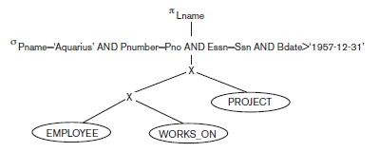
Initial Query Tree

Slide 28
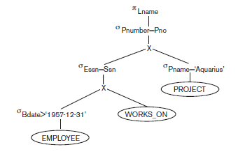
Moving Select Operations down the query tree

Slide 29
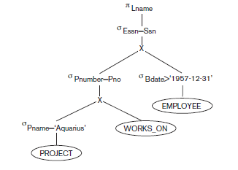
Apply more restrictive Select operation first

Slide 30
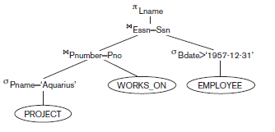
Replacing CARTESIAN PRODUCT and SELECT with JOIN operations.

Slide 31
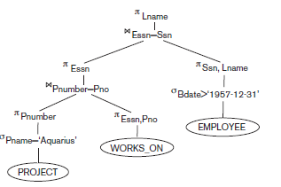
Moving PROJECT operations down the query tree.

